Slide 1
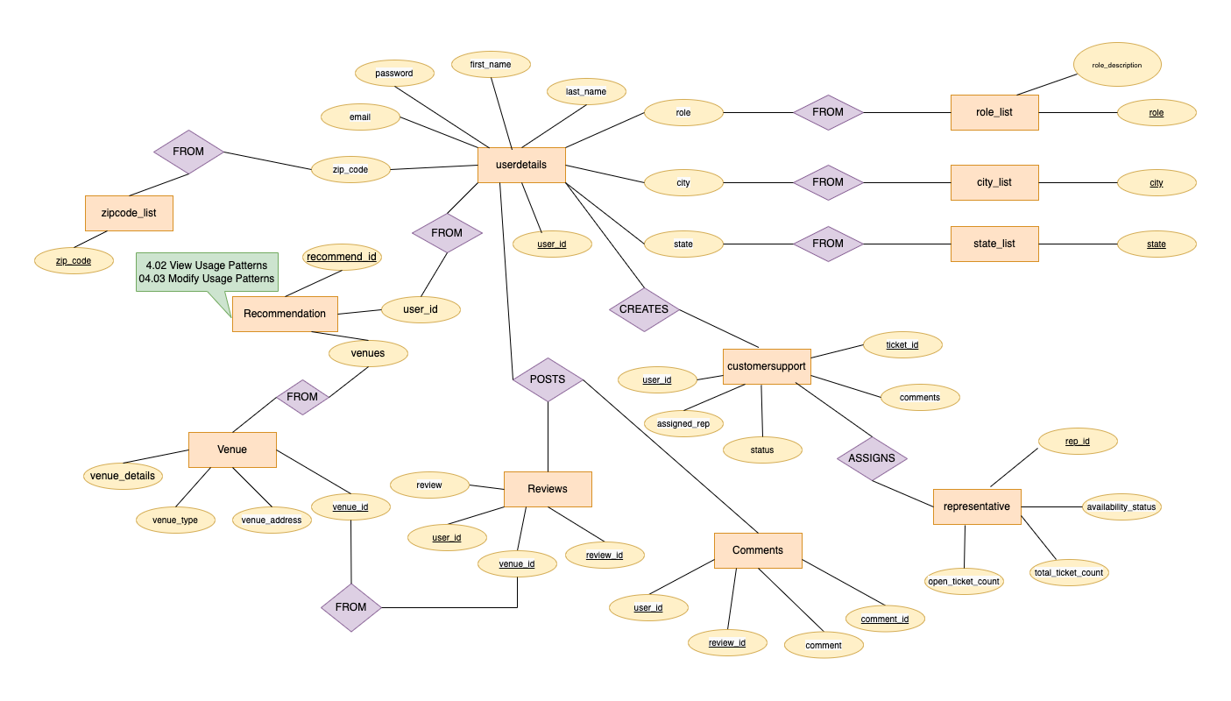
Team4 - Reviewer
Conceptual Diagram

Slide 2
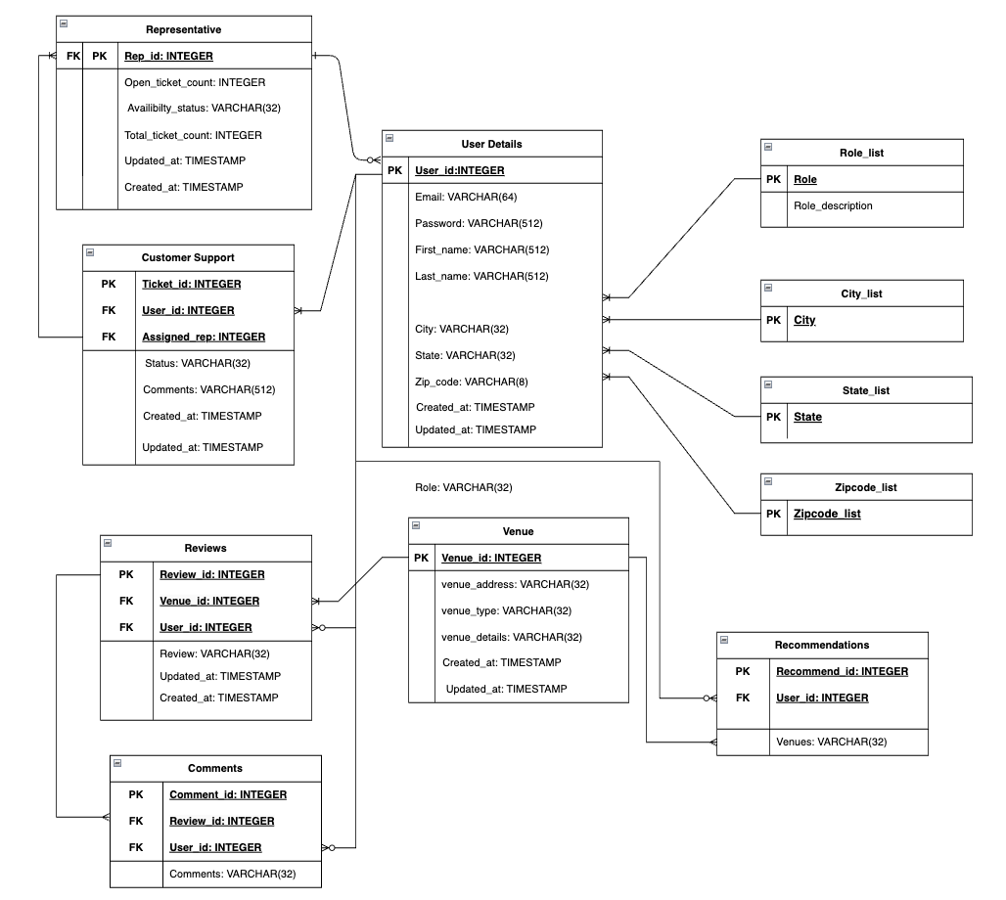
Team4 - Reviewer
Logical ER Diagram

